Slide 1
Assembly polishing
Contig sequence produced by assemblers contains errors, especially if ONT data was used: AGACATAGACGAAGACATAGGTA
We can fix errors by aligning low error reads (Illumina or HiFi) to the assembly: AGACATAGACGA*AGACATAGGTA AGACACAG CACAGACGATAGA ACAGACGATAGACGTAGGT ATAGACGTAGGT AGACCTAGGTA ACGTAGGTA
This is called polishing

Slide 2
Assembly polishing
Caution on polishing: if the reads were not used for the original assembly, they may come from regions that are missing from the assembly, but similar to another region present in the assembly
In this case read aligner may align the reads to the wrong place
Polishing programs try to deal with these cases by looking for reads that agree with the assembly, but in low-coverage regions there may be not enough of them

Slide 3
Evaluating genome assemblies: size
Most eukaryotic genomes are diploid or polyploid:
One chromosome from each parent
Estimated genome size is typically counting each chromosome ONCE
Human genome size is ~3.2G bp
Traditional pseudo-haploid genome assembly is a mosaic of two haplotypes
Total sequence in the assembly:
<< Estimated genome size: incomplete assembly, possibly due to insufficient sequencing depth, collapsed repeats, elimination of short contigs
>>Estimated genome size: redundant assembly, possibly due to extra haplotype variants for heterozygous diploid/polyploid genomes

Slide 4
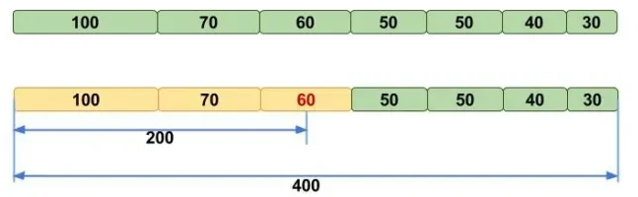
Evaluating genome assemblies: N50
N50 metric: the length of the shortest contig (scaffold) for which longer or equal length contigs (scaffolds) contain at least 50% of the total assembly
NG50 -- N50 that uses estimated genome size instead of assembly size
Image credit: molecularecologist.com

Slide 5
Note about N50
N50 may be unstable when there are only few big contigs in the assembly. For example, for 100Kb genome:
55,25,20 yields N50 of 55
40,35,25 yields N50 of 35
When comparing two assemblies N50, one must use the same assembly size. Using smaller assembly size boosts N50:
Contigs: 70, 60, 50, 30, 20, 10, 10,10, 5, 5, 5, 5 sum=320
N50(G=280)=50, N50(G=260)=60
This is why NG50 is more “fair” when comparing two assemblies of the same organism

Slide 6
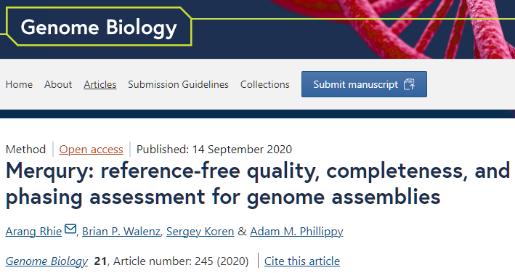
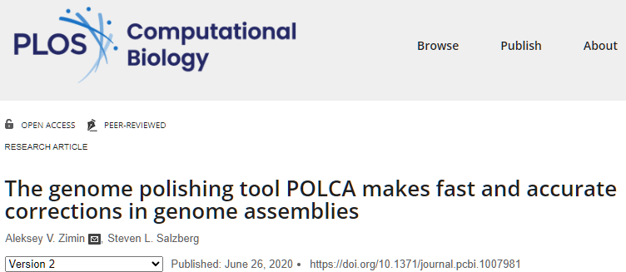
Evaluating genome assemblies: error rate
Consensus error rate can be estimated by aligning accurate reads from the same organism to the assembly
Can use the original reads
Suitable reads: Illumina and PacBio HiFi
Can use alignment-based approach (POLCA) or k-mer based approach (Merqury)

Slide 7
Lab #4: Build K-unitigs from K-mers
Lab #4: Due Friday October 24. The goal for Lab #4 is to write code that parses reads in fastq file, counts canonical K-mers for a given K, and then builds K-unitigs – unique non branching paths of K-mers in a K-mer graph. K-unitigs are genomic sequences. All K-mers in the reads must be present in K-unitigs. Each K-mer of size K must be in only one K-unitig.
Reads are provided in autograder as “read1.fq”. You can assume that this file is in your current directory. Reads are also available on github for testing: https://github.com/alekseyzimin/BME-Algorithms-for-Analysis-of-Genomic-Data/raw/refs/heads/main/read1.fq
Write the following functions in python:
(g:10/u:10) reverse_complement(seq) – returns reverse complement of sequence seq
(g:10/u:10) canonical_kmer(kmer) – returns canonical version of the k-mer kmer using lexicographic order
(g:10/u:20) count_canonical_kmers(file.fastq,k) – reads genome sequences from file.fastq, returns dictionary kmer_counts[kmer]=count for K-mer size k
(g:10/u:20) compute_n50(sequences) -- returns N50 of sequences in the input array sequences
(g:40/u:40) build_unitigs(kmer_counts) – returns array of k-unitig sequences, argument is dictionary kmer_counts produced by count_canonical_kmers
Graduate section only(g:20): run compute_n50(build_unitigs(count_canonical_kmers(fastq_path,k))) code varying K-mer size between 15 and 90, and submit a plot of how K-unitigs N50 varies with K. At which K value the N50(K) is the largest? Add the value in a text box to the plot.

